Slide 1
Holistic Twig Joins: Optimal XML Pattern Matching
Nicholas Bruno, Nick Koudas, Divesh Srivastava
ACM SIGMOD 02
Presented by: Li Wei, Dragomir Yankov

Slide 2
Outline
Problem Statement
PathStack Algorithm
TwigStack Algorithm
Experimental Results

Slide 3
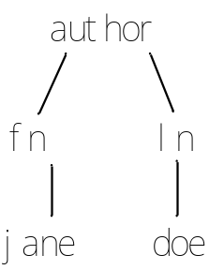
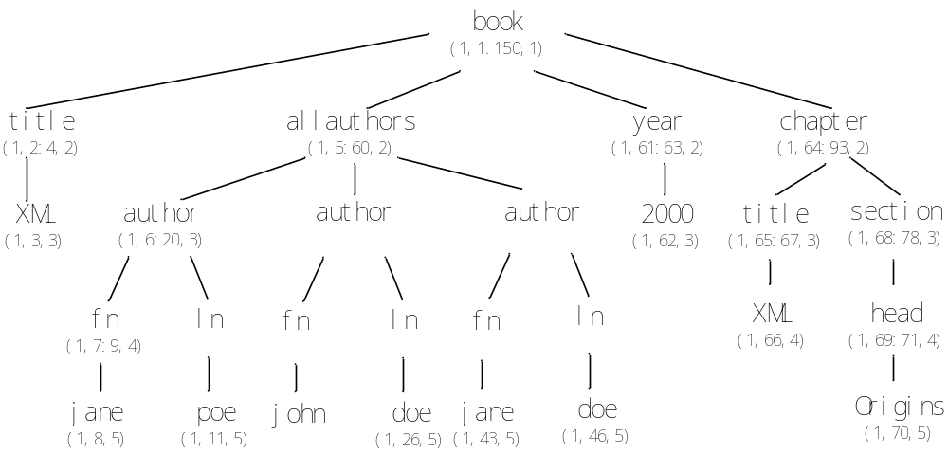
Problem Statement
Given a query twig pattern Q, and a XML database D, compute ALL the answers to Q in D.
Example:
Query
XML document

Slide 4
Binary Structural Joins
The approach
  Decompose the twig pattern into binary structural relationships
  Use structural join algorithms to match the binary relationships against the XML database
  Stitch together the basic matches
The problem
  The intermediate result sizes can get large, even when the input and output sizes are more manageable.

Slide 5
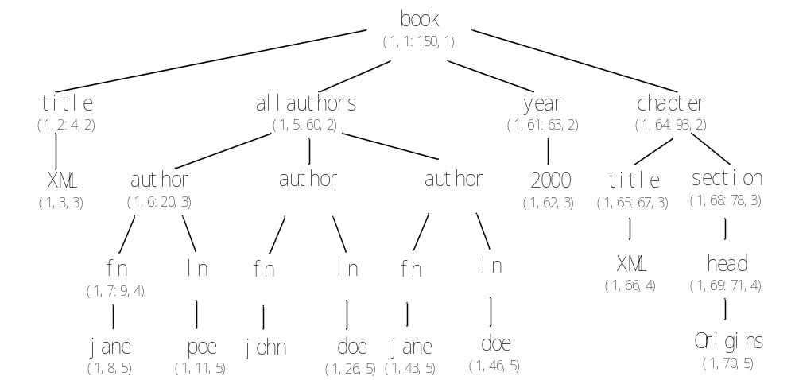
Example
Query
XML document

Slide 6
Example
Query
XML document
Decomposition
author – fn
author – ln
fn – jane
ln – doe

Slide 7
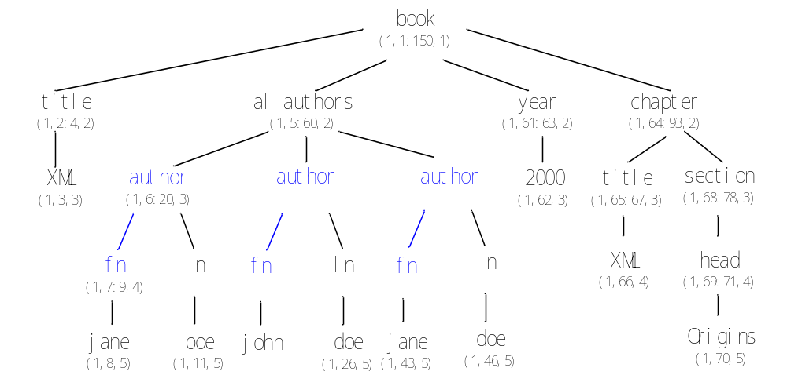
Example
Query
XML document
Decomposition
Number of Intermediate Results
author – fn
author – ln
fn – jane
ln – doe
3

Slide 8
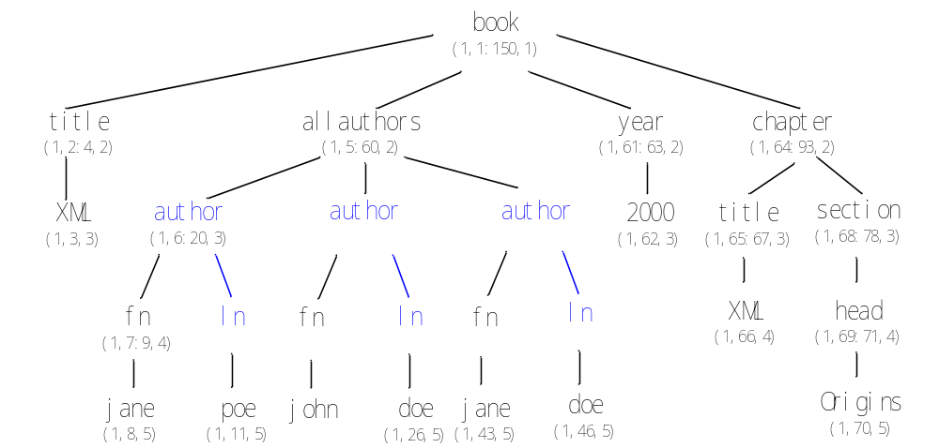
Example
Query
XML document
Decomposition
Number of Intermediate Results
author – fn
author – ln
fn – jane
ln – doe
3
3

Slide 9
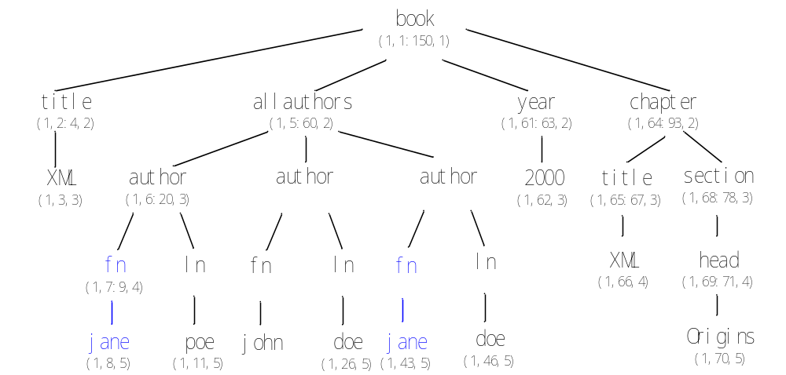
Example
Query
XML document
Decomposition
Number of Intermediate Results
author – fn
author – ln
fn – jane
ln – doe
3
3
2

Slide 10
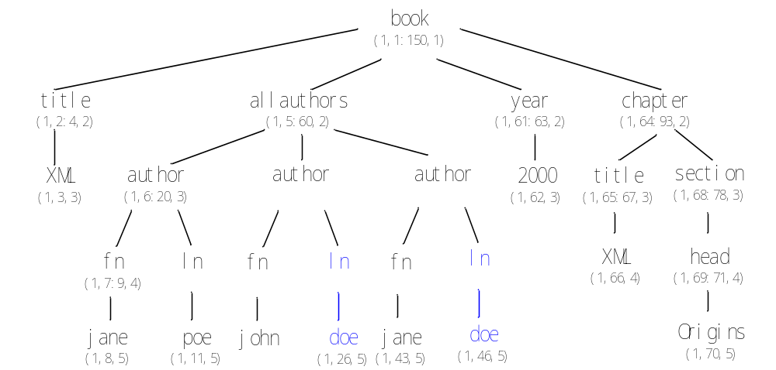
Example
Query
XML document
Decomposition
Number of Intermediate Results
author – fn
author – ln
fn – jane
ln – doe
3
3
2
2

Slide 11
Example
Query
XML document
Decomposition
Number of Intermediate Results
Output
author – fn
author – ln
fn – jane
ln – doe
3
3
2
2
1

Slide 12
Holistic Twig Joins
The approach
  Uses linked stacks to compactly represent partial results to query paths
  Merges results to query paths to obtain matches for the twig pattern
The advantage
  It ensures that no intermediate solutions is larger than the final answer to the query.

Slide 13
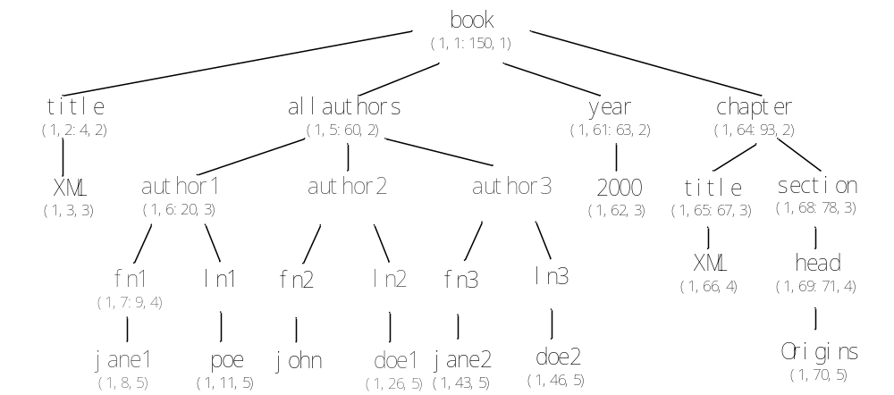
Example
Query
XML document

Slide 14
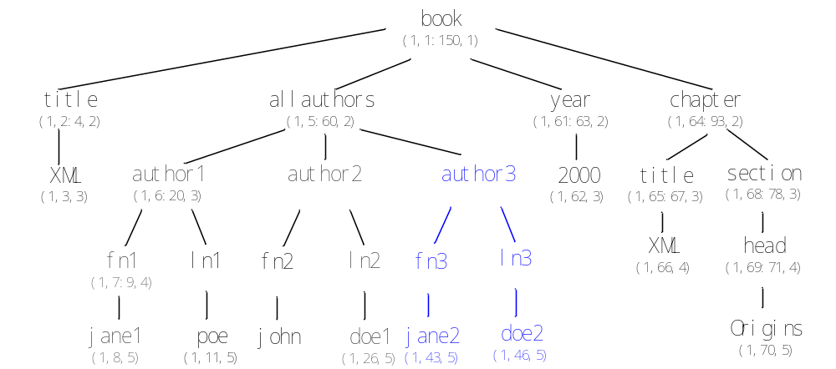
Example
Query
XML document
Decomposition
Intermediate Results
Number of Intermediate Results
Output
author – fn – jane
author – ln – doe
author3 – fn3 – jane2
author3 – ln3 – doe2
1
1
1

Slide 15
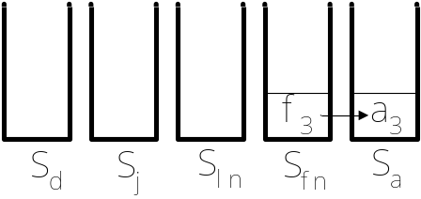
Notation
XML document
Query
Streams
Stacks
T_{a}: a₁, a₂, a₃
T_{fn}: fn₁, fn₃
T_{ln}: ln₂, ln₃
T_{j}: j₁, j₂
T_{d}: d₁, d₂
isLeaf (author) = false
isRoot (author) = true
parent (fn) = author
children (author) = {fn, ln}
subtreeNodes (author) = {fn, ln, jane, doe}
eof (T_{a}) = false
advance (T_{a}) => T_{a}: a₁, a₂, a₃
next (T_{a}) = a₁
nextL (T_{a}) = 6
nextR (T_{a}) = 20
empty (S_{a}) = false
pop (S_{f})
push (S_{ln}, ln₃, pointer to a₃)
topL (S_{a}) = LeftPos of a₃
topR (S_{a}) = RightPos of a₃

Slide 16
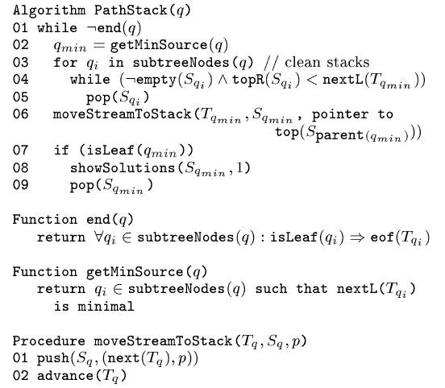
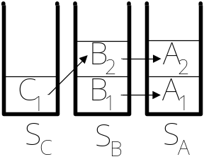

Algorithm: PathStack
Intuition:
While the streams of the leaves are not empty (i.e. a solution could be found) do:
select the node with minimal LeftPos value and push it into stack
if it is a leaf, print the solution
A₁B₁C₁
A₁B₂C₁
A₂B₂C₁

Slide 17
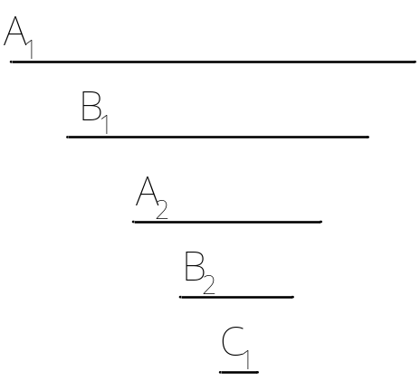
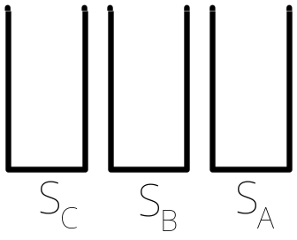
Streams
Stacks
Comments
T_{A}: A₁, A₂
T_{B}: B₁, B₂
T_{C}: C₁
q_{min} = A
06) moveStreamToStack(T_{A}, S_{A}, null)

Slide 18
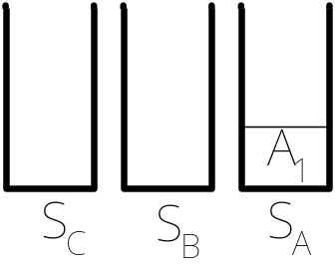
Streams
Stacks
Comments
T_{A}: A₁, A₂
T_{B}: B₁, B₂
T_{C}: C₁
q_{min} = B
06) moveStreamToStack(T_{B}, S_{B}, A₁)

Slide 19
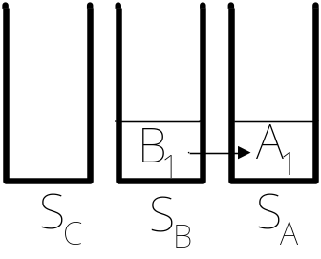
Streams
Stacks
Comments
T_{A}: A₁, A₂
T_{B}: B₁, B₂
T_{C}: C₁
q_{min} = A
06) moveStreamToStack(T_{A}, S_{A}, null)

Slide 20
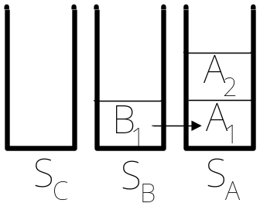
Streams
Stacks
Comments
T_{A}: A₁, A₂
T_{B}: B₁, B₂
T_{C}: C₁
q_{min} = B
06) moveStreamToStack(T_{B}, S_{B}, A₂)

Slide 21
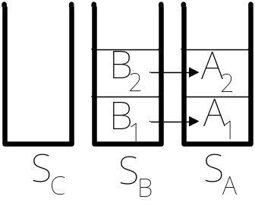
Streams
Stacks
Comments
T_{A}: A₁, A₂
T_{B}: B₁, B₂
T_{C}: C₁
q_{min} = C
06) moveStreamToStack(T_{C}, S_{C}, B₂)

Slide 22
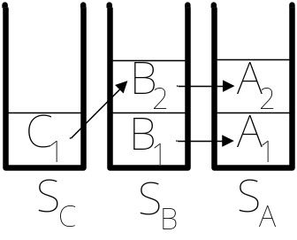
Streams
Stacks
Comments
T_{A}: A₁, A₂
T_{B}: B₁, B₂
T_{C}: C₁
07) isLeaf(C) = true
08) showSolutions(S_{C}, 1)
09) pop(S_{C})

Slide 23
Streams
Stacks
Comments
T_{A}: A₁, A₂
T_{B}: B₁, B₂
T_{C}: C₁
01) end(q) = true
Algorithm ends.

Slide 24
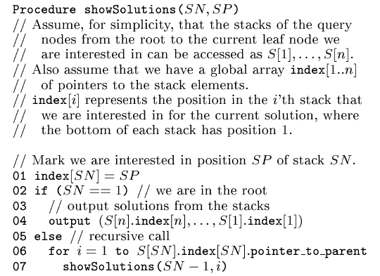
Procedure: showSolutions
Intuition:
- stacks have the compact encodings of the anwers
- output is in leaf-to-root order
C₁B₁A₁
C₁B₂A₁
C₁B₂A₂

Slide 25
Analysis: PathStack
Correctness
  (Theorem 3.1) Given a query path pattern Q and an XML database D, Algorithm PathStack correctly returns all answers for Q on D.
Optimality
  (Theorem 3.2) Algorithm PathStack has worst case I/O and CPU time complexities linear in the sum of sizes of the input lists and the output list.

Slide 26
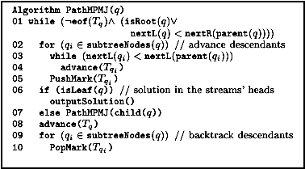
PathMPMJ
T_{A} = A1, A2, A3…
T_{B} = B1, B2 … BK…
T_{C} = C1, C2, C3 …
A naïve extension of MPMGJN could be to backtrack all possible solutions – PathMPMJNaive
A much faster approach is to keep “k” pointers on the streams and prune part of the solutions - PathMPMJ

Slide 27
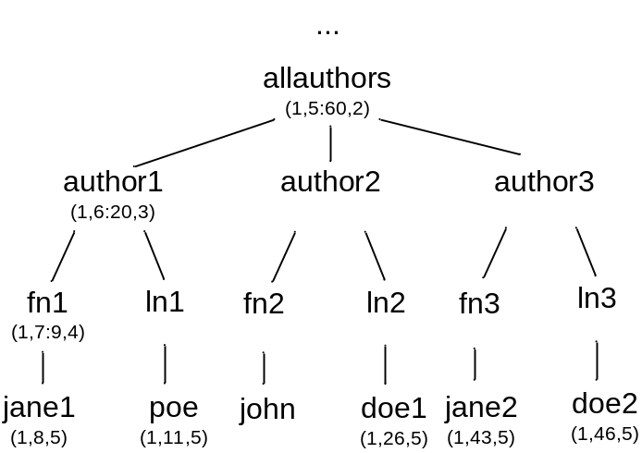
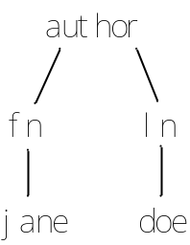


PathStack Limitations
Merging the path queries for twig joins is not optimal
Example:
Query:
Query result:
(a3, fn3, ln3, j2, d2)
(a1, fn1, j1)
(a3, fn3, j3)
(a2, ln2, d2)
(a3, ln3, d3)

Slide 28
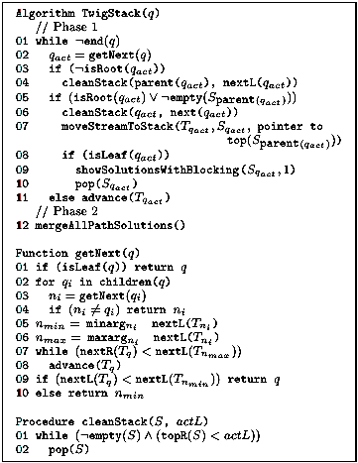
TwigStack
Intuition:
While the streams of the leaves are not empty (i.e. a solution could be found) do:
- select a node that could be expanded to a solution
- if it is a leaf, print the solution

Slide 29
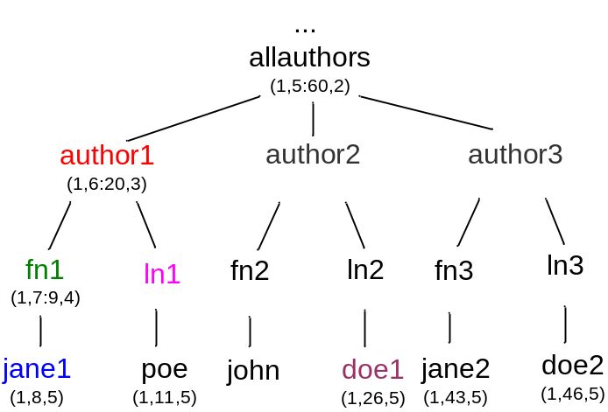
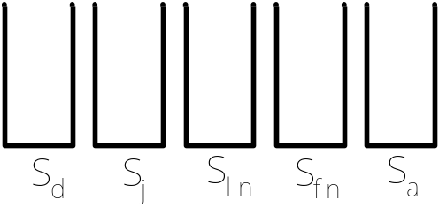
TwigStack: Example
Comments: Phase1
01: while (notEmpty(T_{j}) || notEmpty(T_{d}))
do:
Streams
T_{a}: a1, a2, a3
T_{fn}: fn1, fn2, fn3
T_{ln}: ln1, ln2, ln3
T_{j}: j1, j2
T_{d}: d1, d2
Stacks

Slide 30
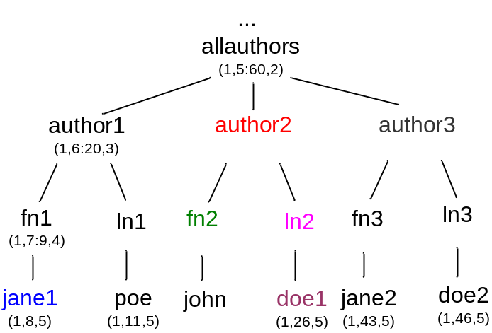
TwigStack: Example
Comments: iteration1
q_{act} = getNext(a) fn
getNext(fn) fn
getNext(j) j
n_{min}=n_{max}=8 (j1)
getNext(ln) ln
getNext(d) d
n_{min}=n_{max}=26 (d1)
advance(ln)
n_{min}=7(fn1)
n_{max}=ln2
advance(T_{a})
advance(T_{fn})
Streams
T_{a}: a1, a2, a3
T_{fn}: fn1, fn2, fn3
T_{ln}: ln1, ln2, ln3
T_{j}: j1, j2
T_{d}: d1, d2
Stacks

Slide 31
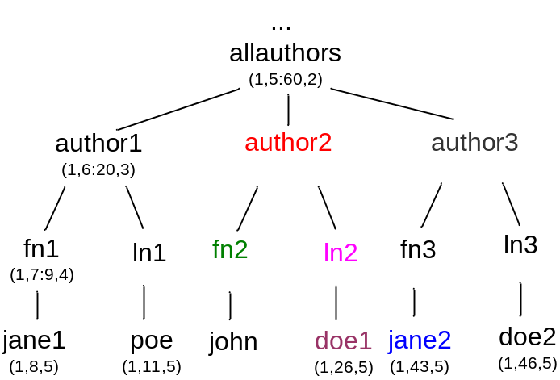
TwigStack: Example
Comments: iteration2
q_{act} = getNext(a) j
getNext(fn) j
getNext(j) j
n_{min}=n_{max}=8 (j1)
getNext(ln) ln
getNext(d) d
n_{min}=n_{max}=26 (d1)
n_{min}=8(j1)
n_{max}=ln2
advance(T_{j})
Streams
T_{a}: a1, a2, a3
T_{fn}: fn1, fn2, fn3
T_{ln}: ln1, ln2, ln3
T_{j}: j1, j2
T_{d}: d1, d2
Stacks

Slide 32
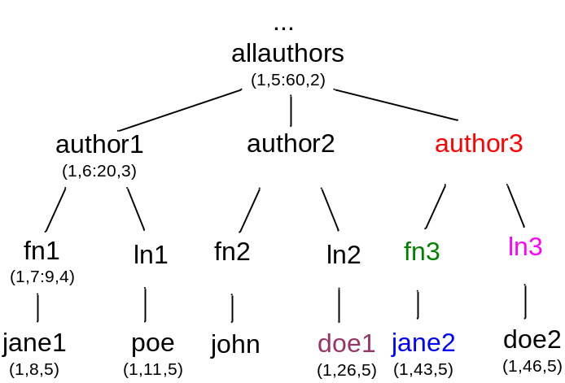
TwigStack: Example
Comments: iteration3
q_{act} = getNext(a) ln
getNext(fn) fn
getNext(j) j
n_{min}=n_{max}=43 (j2)
advance(fn)
getNext(ln) ln
getNext(d) d
n_{min}=n_{max}=26 (d1)
n_{min}=ln2
n_{max}=fn3
advance(T_{a})
advance(T_{ln})
Streams
T_{a}: a1, a2, a3
T_{fn}: fn1, fn2, fn3
T_{ln}: ln1, ln2, ln3
T_{j}: j1, j2
T_{d}: d1, d2
Stacks

Slide 33
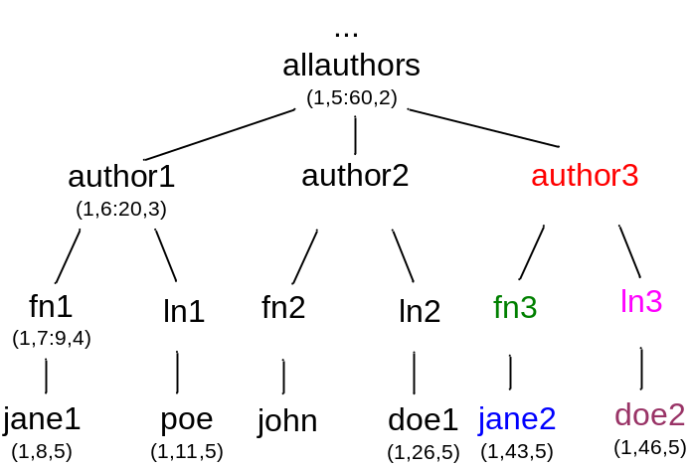
TwigStack: Example
Comments: iteration4
q_{act} = getNext(a) d
getNext(fn) fn
getNext(j) j
n_{min}=n_{max}=43 (j2)
getNext(ln) d
getNext(d) d
n_{min}=n_{max}=26 (d1)
n_{min}=26(d1)
n_{max}=fn3
advance(T_{d})
Streams
T_{a}: a1, a2, a3
T_{fn}: fn1, fn2, fn3
T_{ln}: ln1, ln2, ln3
T_{j}: j1, j2
T_{d}: d1, d2
Stacks

Slide 34
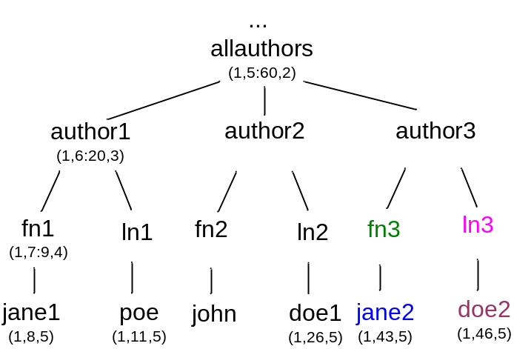
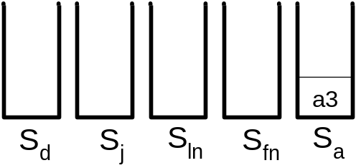
TwigStack: Example
Comments: iteration5
q_{act} = getNext(a) a
getNext(fn) fn
getNext(j) j
n_{min}=n_{max}=43 (j2)
getNext(ln) ln
getNext(d) d
n_{min}=n_{max}=46 (d2)
n_{min}=fn3
n_{max}=ln3
moveStreamToStack(T_{a})
advance(T_{a})
Streams
T_{a}: a1, a2, a3
T_{fn}: fn1, fn2, fn3
T_{ln}: ln1, ln2, ln3
T_{j}: j1, j2
T_{d}: d1, d2
Stacks

Slide 35
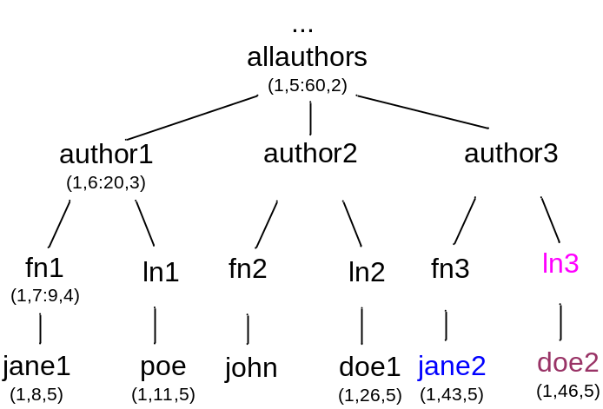
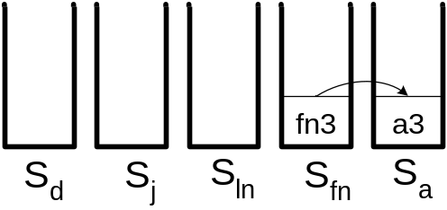
TwigStack: Example
Comments: iteration6
q_{act} = getNext(a) fn
getNext(fn) fn
getNext(j) j
n_{min}=n_{max}=43 (j2)
getNext(ln) ln
getNext(d) d
n_{min}=n_{max}=46 (d2)
n_{min}=fn3
n_{max}=ln3
moveStreamToStack(T_{fn})
advance(T_{fn})
Streams
T_{a}: a1, a2, a3
T_{fn}: fn1, fn2, fn3
T_{ln}: ln1, ln2, ln3
T_{j}: j1, j2
T_{d}: d1, d2
Stacks

Slide 36
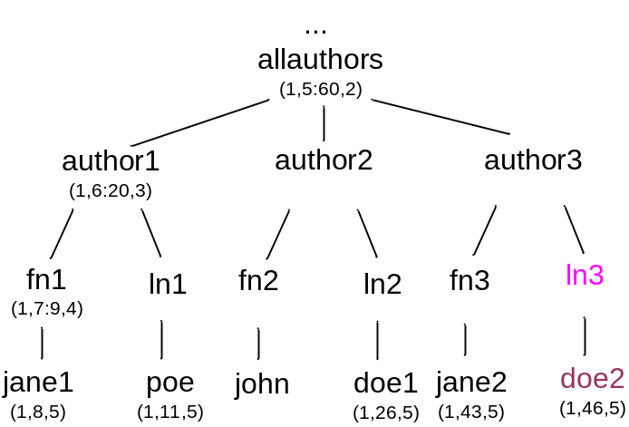
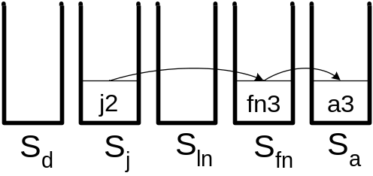
TwigStack: Example
Comments: iteration7
q_{act} = getNext(a) j
getNext(fn) j
getNext(j) j
n_{min}=n_{max}=43 (j2)
getNext(ln) ln
getNext(d) d
n_{min}=n_{max}=46 (d2)
n_{min}=43(j2)
n_{max}=ln3
moveStreamToStack(T_{j})
advance(T_{j})
pop(S_{j})
showSolutionsWithBlocking(j)
Streams
T_{a}: a1, a2, a3
T_{fn}: fn1, fn2, fn3
T_{ln}: ln1, ln2, ln3
T_{j}: j1, j2
T_{d}: d1, d2
Stacks
“Merge-joinable” root-to-leaf path: (j2, fn3, a3)

Slide 37
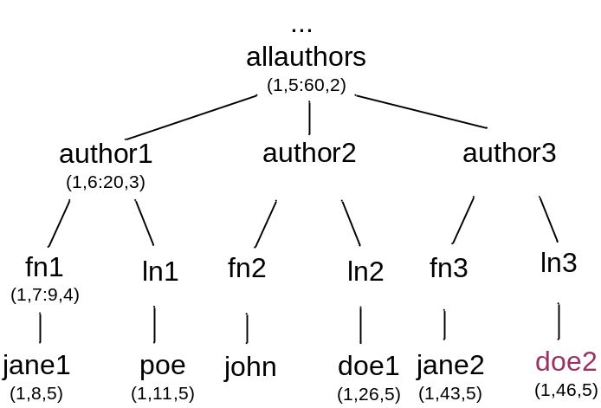
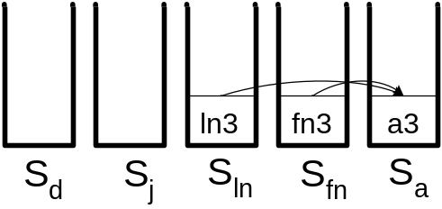
TwigStack: Example
Comments: iteration8
q_{act} = getNext(a) ln3
getNext(fn) nil
getNext(j) nil
n_{min}=n_{max}=nil
getNext(ln) ln
getNext(d) d
n_{min}=n_{max}=46 (d2)
n_{min}=ln3
n_{max}=ln3
moveStreamToStack(T_{ln})
advance(T_{ln})
Streams
T_{a}: a1, a2, a3
T_{fn}: fn1, fn2, fn3
T_{ln}: ln1, ln2, ln3
T_{j}: j1, j2
T_{d}: d1, d2
Stacks
“Merge-joinable” root-to-leaf path: (j2, fn3, a3)

Slide 38
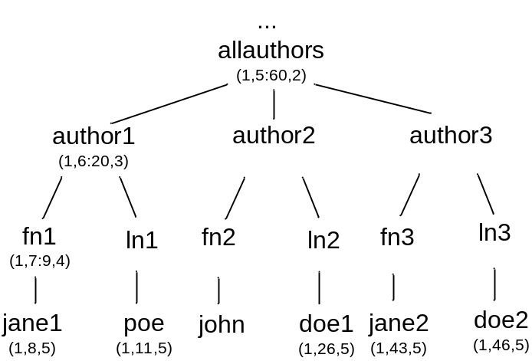
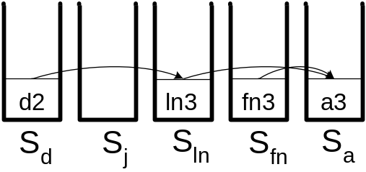
TwigStack: Example
Comments: iteration9
q_{act} = getNext(a) ln3
getNext(fn) nil
getNext(j) nil
n_{min}=n_{max}=nil
getNext(ln) d
getNext(d) d
n_{min}=n_{max}=46 (d2)
n_{min}=d
n_{max}=d
moveStreamToStack(T_{d})
advance(T_{d})
pop(S_{d})
showSolutionsWithBlocking(d)
Streams
T_{a}: a1, a2, a3
T_{fn}: fn1, fn2, fn3
T_{ln}: ln1, ln2, ln3
T_{j}: j1, j2
T_{d}: d1, d2
Stacks
“Merge-joinable” root-to-leaf paths: (j2, fn3, a3)
(d2, ln3, a3)

Slide 39
TwigStack: Example
Comments: Phase2
12: MergeAllPathSolutions()
Streams
T_{a}: a1, a2, a3
T_{fn}: fn1, fn2, fn3
T_{ln}: ln1, ln2, ln3
T_{j}: j1, j2
T_{d}: d1, d2
Stacks
TwigStack solution:
(j2, fn3, d2, ln3, a3)

Slide 40

Analysis of TwigStack
Let getNext(q) = q_{N}
  q_{N} has minimum descendant extension
  for all qi subtreeNodes(q_{N}) next(T_{qi}) = h_{qi}
  Either q=q_{N} or parent(q_{N}) has no min right extension
Any ancestor of q_{N} whose extension uses h_{qn} is returned by getNext before q_{N} => correctness (TwigStack finds all solutions to q)
TwigStack is time and space optimal for ancestor-descendant edges

Slide 41
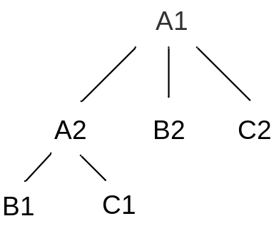
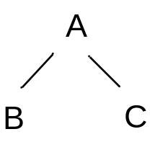
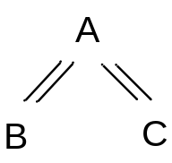
Suboptimality for parent-child edges
Example
TS Phase1 solutions:
(A1, B2, C2)
(A2, B1, C1)
(A1, B1, C1)
(A1, B1, C2)
final solutions
Would be optimal for:

Slide 42
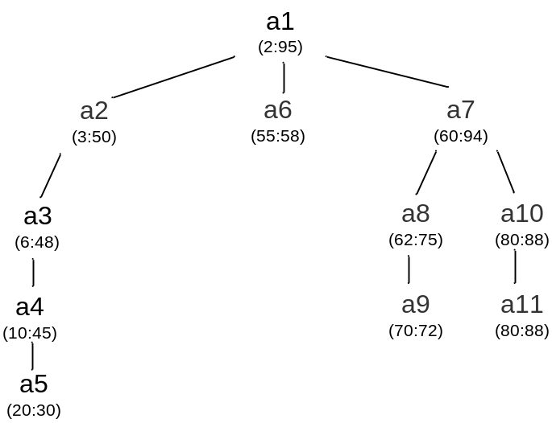
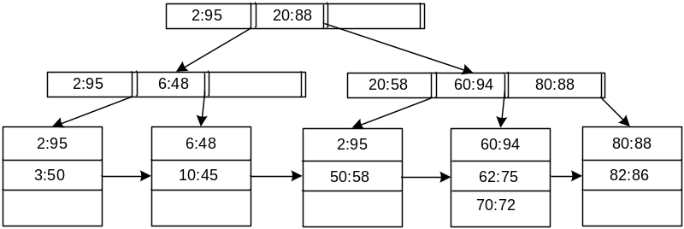
TwigStack and XB-Trees
XB-Trees - B+ trees with some additional features¹
  Internal nodes have the form [L:R], sorted on L
  Parent node interval includes child node intervals
  Each page P has pointer P.parent
TwigStackXB – same as TwigStack with the following modifications
  T_{q} for a query node with an index is now the XB tree rather than a stream
  The advance operation is modified according to the pointer act=(actPage,actIndex)
  The drilldown operation is introduced
1. “An Evaluation of XML indexes for Structural Join” demonstrates that while all – B+, XR and XB trees build the same tree structure, for “highly recursive” XML XB trees outperform the other two

Slide 43
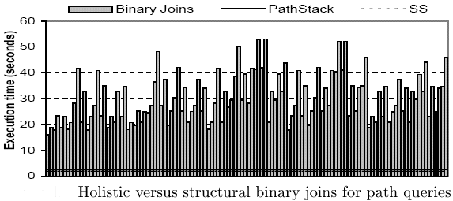
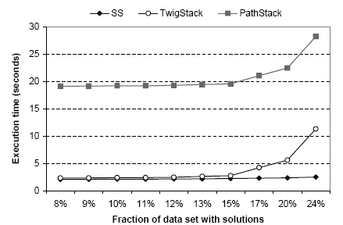
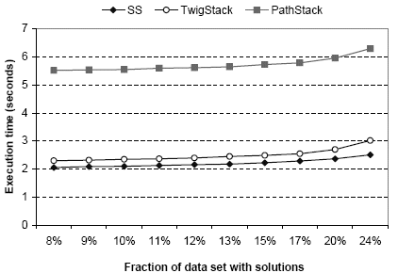
Experimental Results
PS vs TS for binary twig query
PS vs TS for parent-child query

Slide 44
Questions?

